Slide 1
ITSC 306: Computer Forensics
Module 4, Week 4: Volatile Memory Captures

Slide 2
Module Readings
The halpomeranz/lmg README section (https://github.com/halpomeranz/lmg)

Slide 3
Introduction: Volatile Memory Captures
When digital forensics first became mainstream, the standard practice was to pull the plug from the back of the computer, or hold the power button on a laptop to force a hard shut-down.
Today, forensic practitioners no longer pull the plug.
Specialized tools and documented processes have provided the opportunity to collect valuable data.

Slide 4
Why Collect Volatile Memory?
Everything that runs on the operating system passes through RAM.
As privacy becomes increasingly important, RAM may be the only evidence of a program being run.
The size of RAM in a system continues to increase, providing an opportunity to acquire a secondary file system if tools can parse the data.
RAM is the best, and sometimes only, place to collect evidence of malware or bypass whole disk encryption.

Slide 5
RAM - Concerns
RAM is volatile, meaning it does not store data in the long term.
Once the computer is shut down, RAM is flushed from the system.
RAM must be collected on a live running system.
Collecting RAM adds a footprint to the system. The analyst must interact with the running system.
Not collecting RAM intentionally destroys possible evidence.

Slide 6
What Can RAM Provide?
Evidence of malware
Encryption keys
Usernames and passwords
Registry keys
Evidence of open files on a system
IP addresses
URLs
Running processes

Slide 7
Scenario – Full-Disk Encryption
A live computer system is seized by the police.
The officer pulls the power from the back of the system, as she has been trained.
The system is sent to the analyst for forensics.
After the system is imaged, the analyst confirms that the entire drive is encrypted with Truecrypt.
The analysis is over.
If RAM was collected, the encryption keys could have been obtained from the RAM to break the encryption.

Slide 8
Windows Memory Acquisition
RAM is collected by a USB drive configured with specialized tools.
It allows the capture to be completed on-site and with very little interaction with the system.
The size of the USB must be larger than the amount of RAM to be acquired.

Slide 9
Windows RAM Captures - Tools
Two easy and free tools are Imager Lite from Accessdata and DumpIt from Comae:
Imager_Lite_3.1.1 (www.accessdata.com/product-download/digital-forensics)
DumpIt.exe https://comae.typeform.com/to/XlvMa7 (https://www.typeform.com)
Each tool can be installed on a USB drive and captures RAM directly to the same installation drive.

Slide 10
Example - DumpIt
Obtain the executable from the web-site.
Copy the file to the USB drive.
On a live running Windows system, plug the USB into the system and note the assigned drive letter.
Open an Administrator Command Prompt and navigate to the drive letter.
Run the DumpIt.exe executable.
DumpIt runs and creates a RAM dump onto the USB drive.

Slide 11
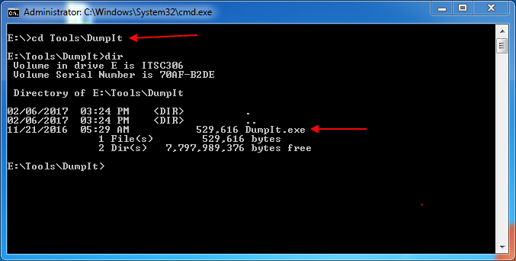
DumpIt
Used with permission from Microsoft.
Notes:
Open an Administrator Command Prompt and navigate to the DumpIt executable.

Slide 12
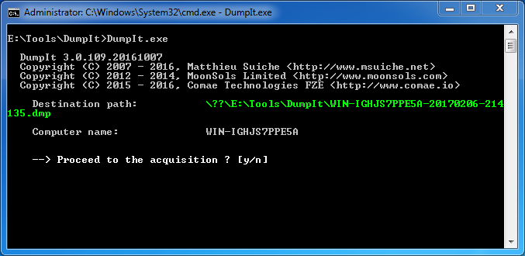
Used with permission from Microsoft.
Notes:
Step 2 – Run the DumpIt executable. Select yes when requested.

Slide 13
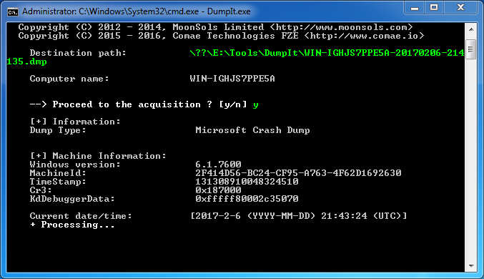
Used with permission from Microsoft.
Notes:
DumpIt will start to collect the RAM, providing date and time info and system info.

Slide 14
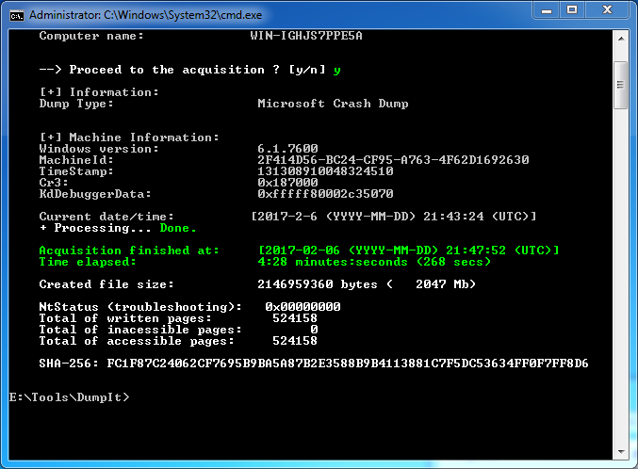
Used with permission from Microsoft.
Notes:
Once completed, DumpIt reports the capture is over, it provides data and time info, and creates a SHA-256 hash value of the capture.

Slide 15
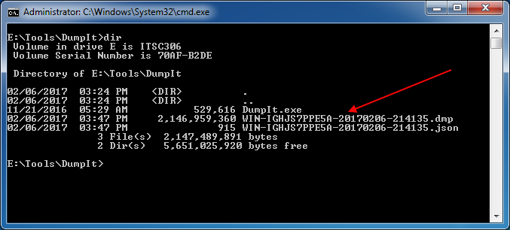
Used with permission from Microsoft.
Notes:
The capture is identified by the system name, date and time and the extension .dmp.

Slide 16
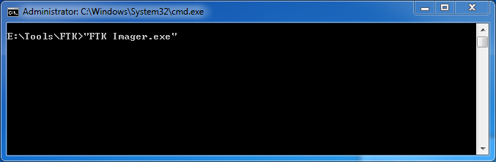
Example – FTK Imager
FTK Imager Lite can also be installed to a USB drive.
FTK Imager Lite presents the user with a GUI.
Once installed on a USB, run the executable.
Used with permission from Microsoft.

Slide 17
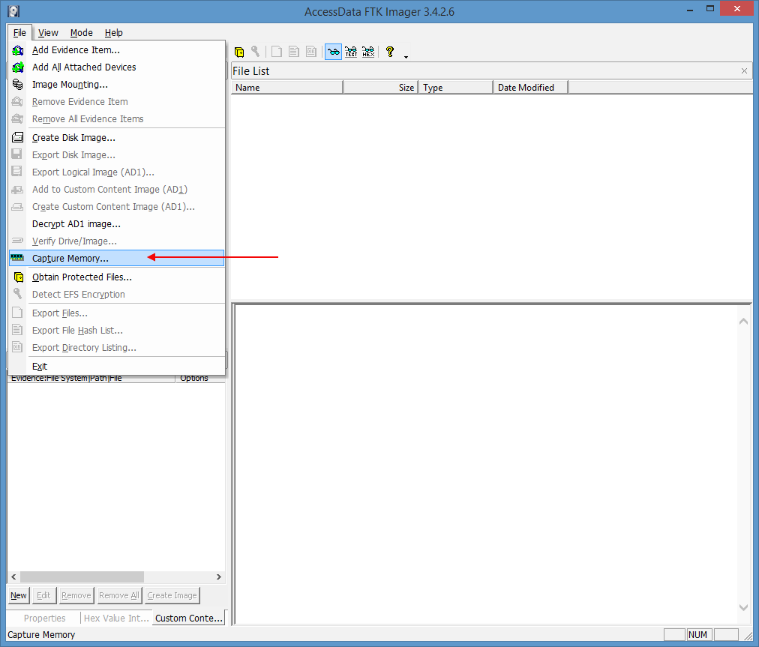
Select Capture Memory
Source: FTK Imager Lite software. Reproduced and used in accordance with the fair dealing provisions in section 29 of the Canadian Copyright Act for the purposes of education, research or private study. Further distribution may infringe copyright.

Slide 18
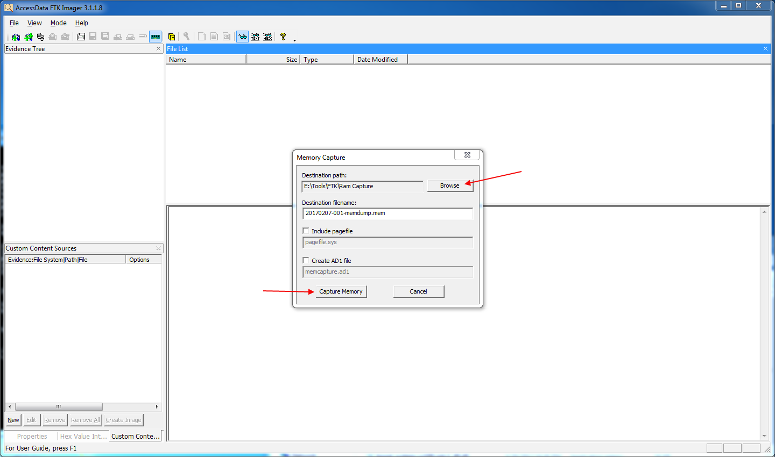
Source: FTK Imager Lite software. Reproduced and used in accordance with the fair dealing provisions in section 29 of the Canadian Copyright Act for the purposes of education, research or private study. Further distribution may infringe copyright.
Notes:
A [ Memory Capture ] window will open. Browse to a path on your USB drive, and name the destination filename with the date – reference number – description. The default extension is [ .mem ]. At this point, you are provided with the option of acquiring the [ pagefile.sys ] by selecting the check box.

Slide 19
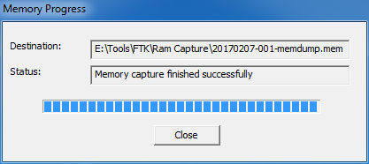
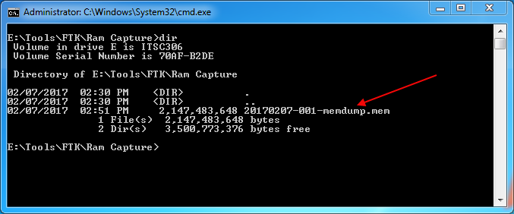
Source: FTK Imager Lite software. Reproduced and used in accordance with the fair dealing provisions in section 29 of the Canadian Copyright Act for the purposes of education, research or private study. Further distribution may infringe copyright.
Used with permission from Microsoft.
Notes:
Imager will start working and will provide a progress window.
Once the memory has been acquired, Imager will report that the [ Memory capture finished successfully ].

Slide 20
Linux Memory Acquisition
Unlike the capture of volatile memory from a Windows Operating System, which is straightforward using tools such as DumpIt or FTK Imager, the Linux kernel presents difficulties.
Since the Linux kernel upgrade to 2.6, the user can no longer use DD to capture the /dev/mem data.
Third party tools have been created to capture RAM from a Linux OS.

Slide 21
LiME – Linux Memory Extractor
LiME is the Linux Memory Extractor created by Joe Sylve.
To use this tool, you must compile a Linux module configured specifically to the target system.
This makes it difficult when you don’t know the system you will encounter.

Slide 22
LMG – Linux Memory Grabber
lmg, or the Linux Memory Grabber, is a script created by Hal Pomeranz.
lmg works similar to DumpIt or FTK Imager.
The script is created on a USB drive.
The drive is connected to the target system.
The script is executed and captures the RAM.

Slide 23
Important
From the required reading, note that this script interacts with the system.
The drive has to be mounted.
A kernel module is built for the system.
The script requires dependencies.
It is run in memory.
As stated in Windows RAM captures, not capturing the RAM may destroy possible evidence.

Slide 24
Tools Required
To create the USB, three programs are required:
The lmg script: lmg-master.zip (https://github.com/halpomeranz/lmg)
The LiME program: Lime-master.zip (https://github.com/504ensicsLabs/LiME)
Volatility: Volatility 2.3.1.zip (www.volatilityfoundation.org/releases)
lmg can create Volatility profiles for later analysis.

Slide 25
Acquiring RAM for Linux
Obtain the three programs.
Configure the USB.
On a live running Linux system:
On the SIFT, the drive will be mounted to /media.
Open a terminal and navigate to the drive.
Run the script.
lmg runs and creates a RAM dump to the USB drive.

Slide 26
Acquiring RAM for Linux
lmg requests to build a LiME kernel module.
lmg dumps the memory into a capture folder on the USB drive.
lmg captures a copy of the /bin/bash file.
lmg requests to compile a profile for the system to be used with Volatility.

Slide 27
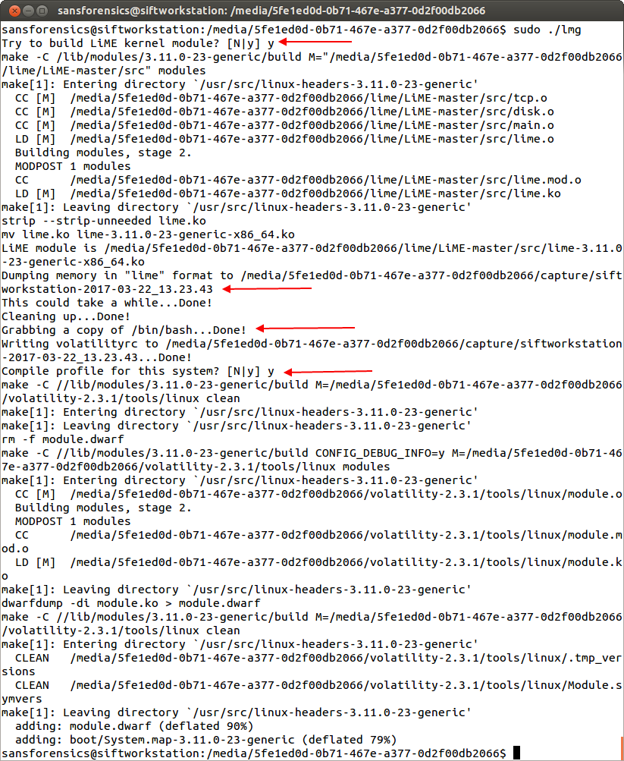

Slide 28
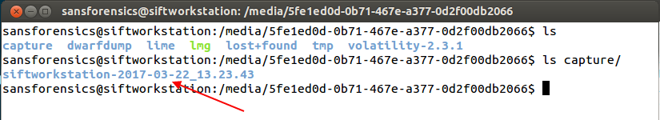
The capture is dated and located in the capture folder created on the USB drive.

Slide 29
Virtual Machine Memory Captures
Memory captures can also be obtained from virtual machines.
Most Virtual Machines keep a snapshot of their memory.
VMWare creates a .vmem file.
Parallels creates a .mem file.
Microsoft Hyper-V creates a .bin file.

Slide 30
Obtaining Virtual Machine RAM
Suspending the virtual machine causes a copy of the memory to be saved to the host system.
These files can be obtained during forensics.
Memory can also be obtained by using the same techniques discussed in this lecture based on the Virtual Machine OS.
Source: Guidance Software

Slide 31
Windows – hiberfil.sys
hiberfil.sys is a compressed copy of RAM created by Windows when the system goes into hibernation.
Found at C:\hiberfil.sys
During forensic analysis, the hiberfil.sys can be carved out and used by forensic analysis tools.
Source: Guidance Software

Slide 32
Pagefile.sys
The Windows pagefile.sys can also be obtained during RAM captures.
The pagefile is a swap file or Windows virtual memory.
The pagefile is used when the Windows OS runs out of physical memory.
Tools such as FTK Imager obtain the pagefile during RAM captures.
Source: Guidance Software

Slide 33
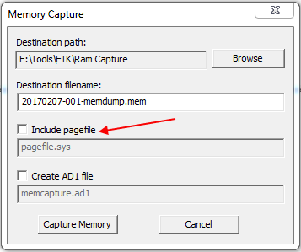
Select the Include pagefile Checkbox

Slide 34
Summary
Capturing RAM is essential to any forensic analysis.
Because everything runs through RAM, it is an important avenue of investigation.
Current tools support parsing the data during analysis.
RAM is the best and sometimes only place to collect evidence of malware or bypass whole disk encryption.
Tools are available to collect RAM from Windows and Linux.

Slide 35
References
AccessData. (2010) FTK Imager Lite (Version 3.1.1) [Computer software]. Retrieved from http://accessdata.com/product-download/ftk-imager-lite-version-3.1.1
Pomeranz, H. (2016) lmg [Computer software]. Retrieved from https://github.com/halpomeranz/lmg.

Slide 36
© 2017, Southern Alberta Institute of Technology. All rights reserved.
This publication and materials herein are protected by applicable intellectual property laws. Unauthorized reproduction and distribution of this publication in whole or part is prohibited.
For more information, contact:
Director, Centre for Instructional Technology and Development
Southern Alberta Institute of Technology
1301 16 Ave. N.W., Calgary, AB T2M 0L4

